Slide 1

Anatomy & Physiology
AN INTEGRATIVE APPROACH
Third Edition
Sistema Nervioso
Michael P. McKinley
Valerie Dean O’Loughlin
Theresa Stouter Bidle
See separate PowerPoint slides for all figures and tables pre-inserted into PowerPoint without notes.
© 2019 McGraw-Hill Education. All rights reserved. Authorized only for instructor use in the classroom. No reproduction or further distribution permitted without the prior written consent of McGraw-Hill Education.

Slide 2
12.4c Mielinización
Mielinización: proceso por el cual se envuelve el axon con capas de mielina (vainas)
  Mielina: cubre en varias capas la membrana del axón
    Lípidos, blanco brillante, aislamiento de gliales
    neurolemnocitos SNP; oligodendrocitos SNC

Slide 3
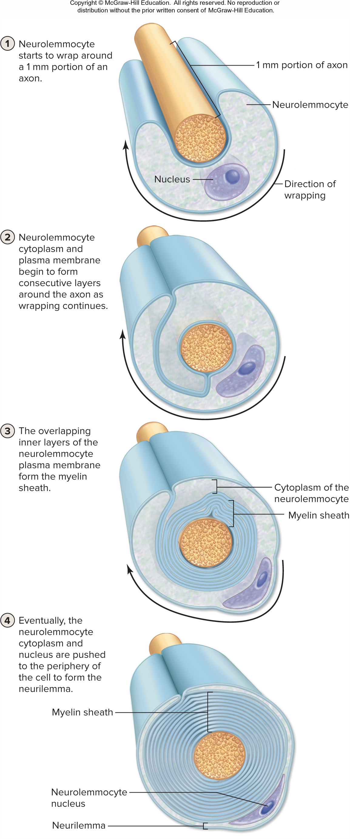
Myelination of PNS Axons
  SNP
    Neurolemnocito rodea el axon
    Vainas de mielina
    Espacios entres los neurolemnocitos se llaman nodos
    Nodos de Ranvier
    Facilitan la conducta saltatorial
    Menos Resistencia
    Mas rapido
Figure 12.7

Slide 4
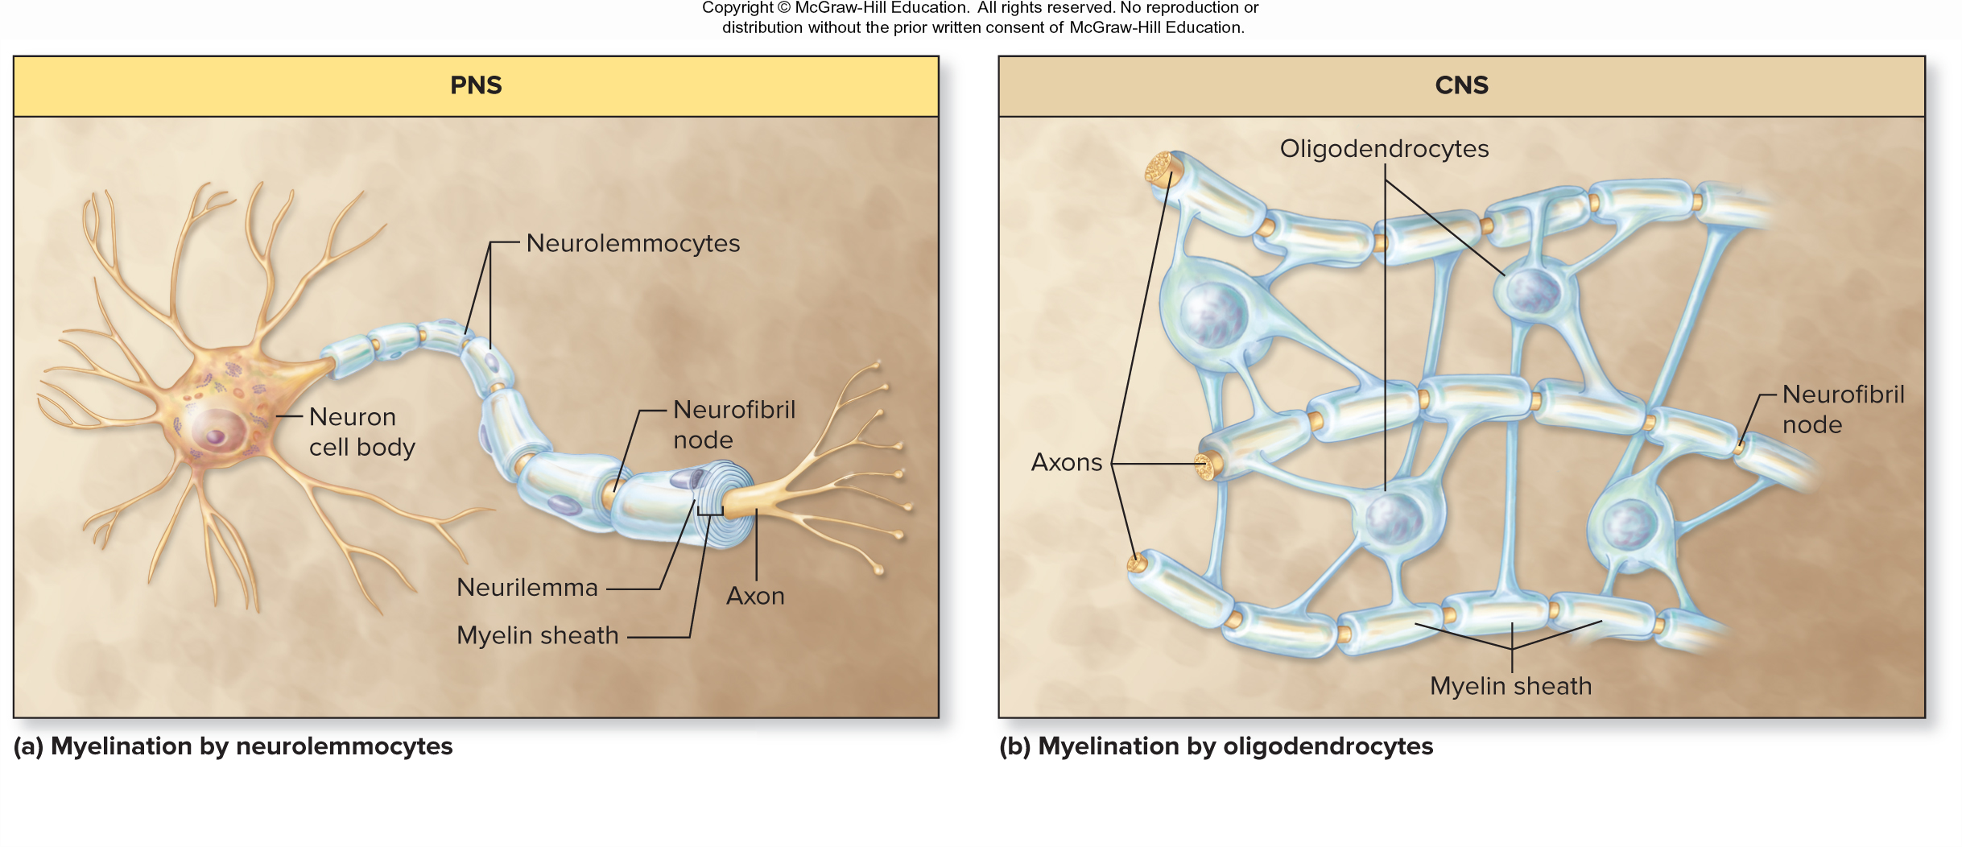
Myelination by Neurolemmocytes
Figure 12.8a

Slide 5
Myelination by Oligodendrocytes
SNC
  oligodendrocitos can mieliniza multiples axons en muchos lugares
  Nodos de Ranvier Tambien estan presentes
Figure 12.8b

Slide 6
Desordenes de Mielina
Esclerosis Multiple
  Demialinizacion Progresiva en el SNC
  Autoinmune: oligodendrocytes atacados por celulas inmunes
  Ataques terminan en inflamaciones
  Inflamaciones terminan en cicatrices, no funcionales
Sindrome Guillain-Barré
  Perdida de mielina por inflamacion de nervios periferales
  Debilidad muscular desde distal a proximal

Slide 7
12.5 Regeneración Axonal1
Puede ocurrir si:
  Cuerpo neuronal intacto
  Daños no son extensos
  Distancia entre sitio afectado y estructura inervada es pequeña

Slide 8
12.5 Axon Regeneration 2
Steps of axon regeneration
  1) Axon severed by trauma
  2a) Proximal to the cut: the axon seals off and swells
  2b) Distal to the cut: the axon and sheath degenerate (Wallerian
  degeneration) but the neurilemma survives
  3) Neurilemma and endoneurium form a regeneration tube
  Axon regenerates guided by nerve growth factors released by neurolemmocytes
  Axon reinnervates original effector or sensory receptor

Slide 9
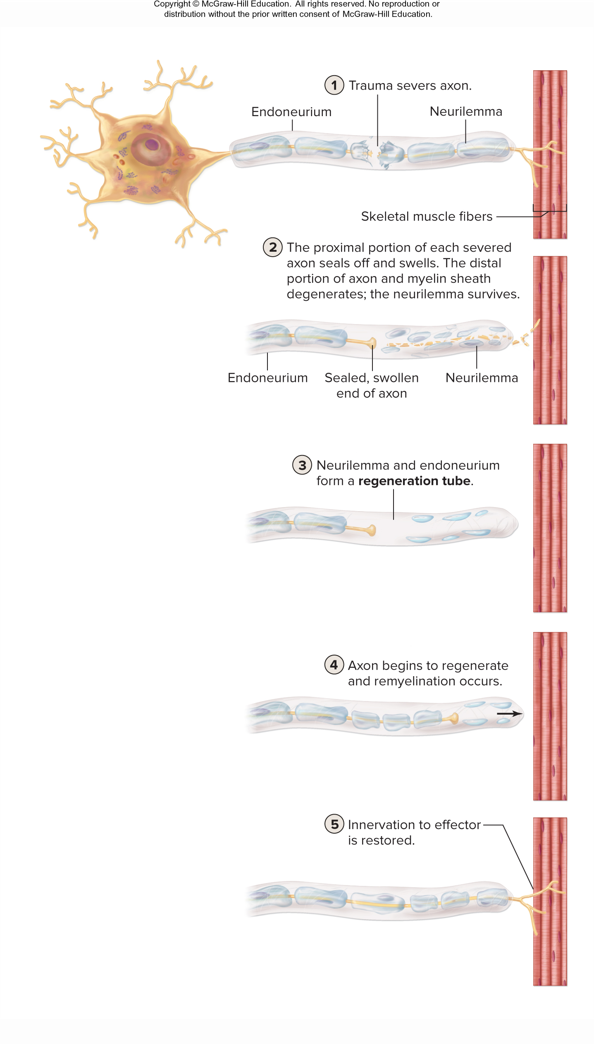
Regeneration of PNS Axons
  1) Axon dañado por trauma
  2a) Proximal al corte: el axon se incha y sella
  2b) Distal al corte: degeneracion Walleriana ( de la vaina
  3) Endoneuro regenera tubo
  NG Factors liberados or neurolemnocitos guian al axon
  Axon re inerva al efecto o estructura original
  Limitada por :
  - Moleculas que inhiben crecimientos producidas por oligodendrocitos
  - Sobrepoblacion de axons
  - Cicatrices de astrocitos y otros gliales traumatizadas
Figure 12.10

Slide 10
12.6 Plasma Membrane of Neurons
Learning Objectives
Distinguish between a pump and a channel, and describe the three specific states of a voltage-gated Na⁺ channel.
List the channels and pumps that are located along the entire neuron, and identify the general function of each.
Identify and describe the four functional neuron segments, including the distribution of channels and pumps in each.

Slide 11
12.6a Types of Pumps and Channels 1
Pumps
  Membrane proteins that maintain a concentration gradient by moving substances against their concentration gradient
  Require cellular energy
  Neurons have sodium-potassium pumps and calcium pumps in their membranes

Slide 12
12.6a Types of Pumps and Channels 2
Channels
  Protein pores in the membrane that allow ions to move down their concentration gradients (into or out of the cell)
    When open they allow a specific type of ion to diffuse
  Leak ( passive) channels are always open for continuous diffusion
  Chemically gated channels are normally closed, but open when neurotransmitter binds
  Voltage-gated channels are normally closed, but open when membrane charge changes

Slide 13
12.6a Types of Pumps and Channels 3
Three states of voltage-gated Na⁺ channels
  Resting state
    Activation gate closed; inactivation gate open
    Entry of Na⁺ prevented
  Activation state
    Activation gate open (due to voltage change); inactivation gate open
    Na⁺ moves through channel
  Inactivation state
    Activation gate open; inactivation gate closed
    Entry of Na⁺ prevented
    This state lasts a short time—the channel quickly resets to resting state

Slide 14
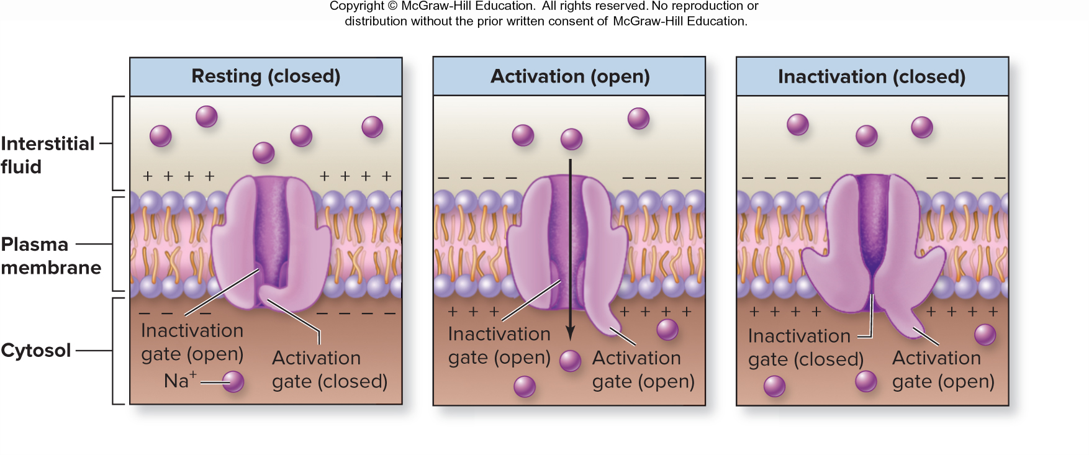
Voltage-Gated Sodium Channels
Because voltage-gated sodium channels have two gates, they can be in three states
Figure 12.11

Slide 15
12.6a Types of Pumps and Channels 4
Modality gated channels
  Normally closed, but open in response to a stimulus other than a chemical or a voltage change
  Found in membranes of sensory neurons that respond to changes in their environment
    E.g., some receptor neurons of the skin have modality gated channels that open in response to mechanical pressure

Slide 16
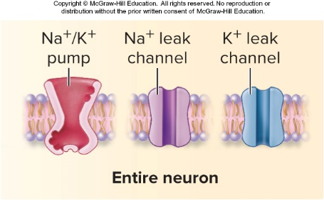
12.6b Distribution of Pumps and Channels 1
Entire plasma membrane of neuron:
  Leak channels (e.g., K⁺ leak channels)
  Na⁺/K⁺ pumps
  Maintain resting membrane potential
Figure 12.12a

Slide 17
12.6b Distribution of Pumps and Channels 2
Plasma membrane of functional segments in a neuron:
  Receptive segment (dendrite and cell body)
    Chemically gated channels (e.g., chemically gated Cl– channels)
  Initial segment (axon hillock)
    Voltage-gated Na⁺ channels and voltage-gated K⁺ channels
  Conductive segment (axon and its branches)
    Voltage-gated Na⁺ channels and voltage-gated K⁺ channels
  Transmissive segment (synaptic knobs)
    Voltage-gated Ca²⁺ channels and Ca²⁺ pumps

Slide 18
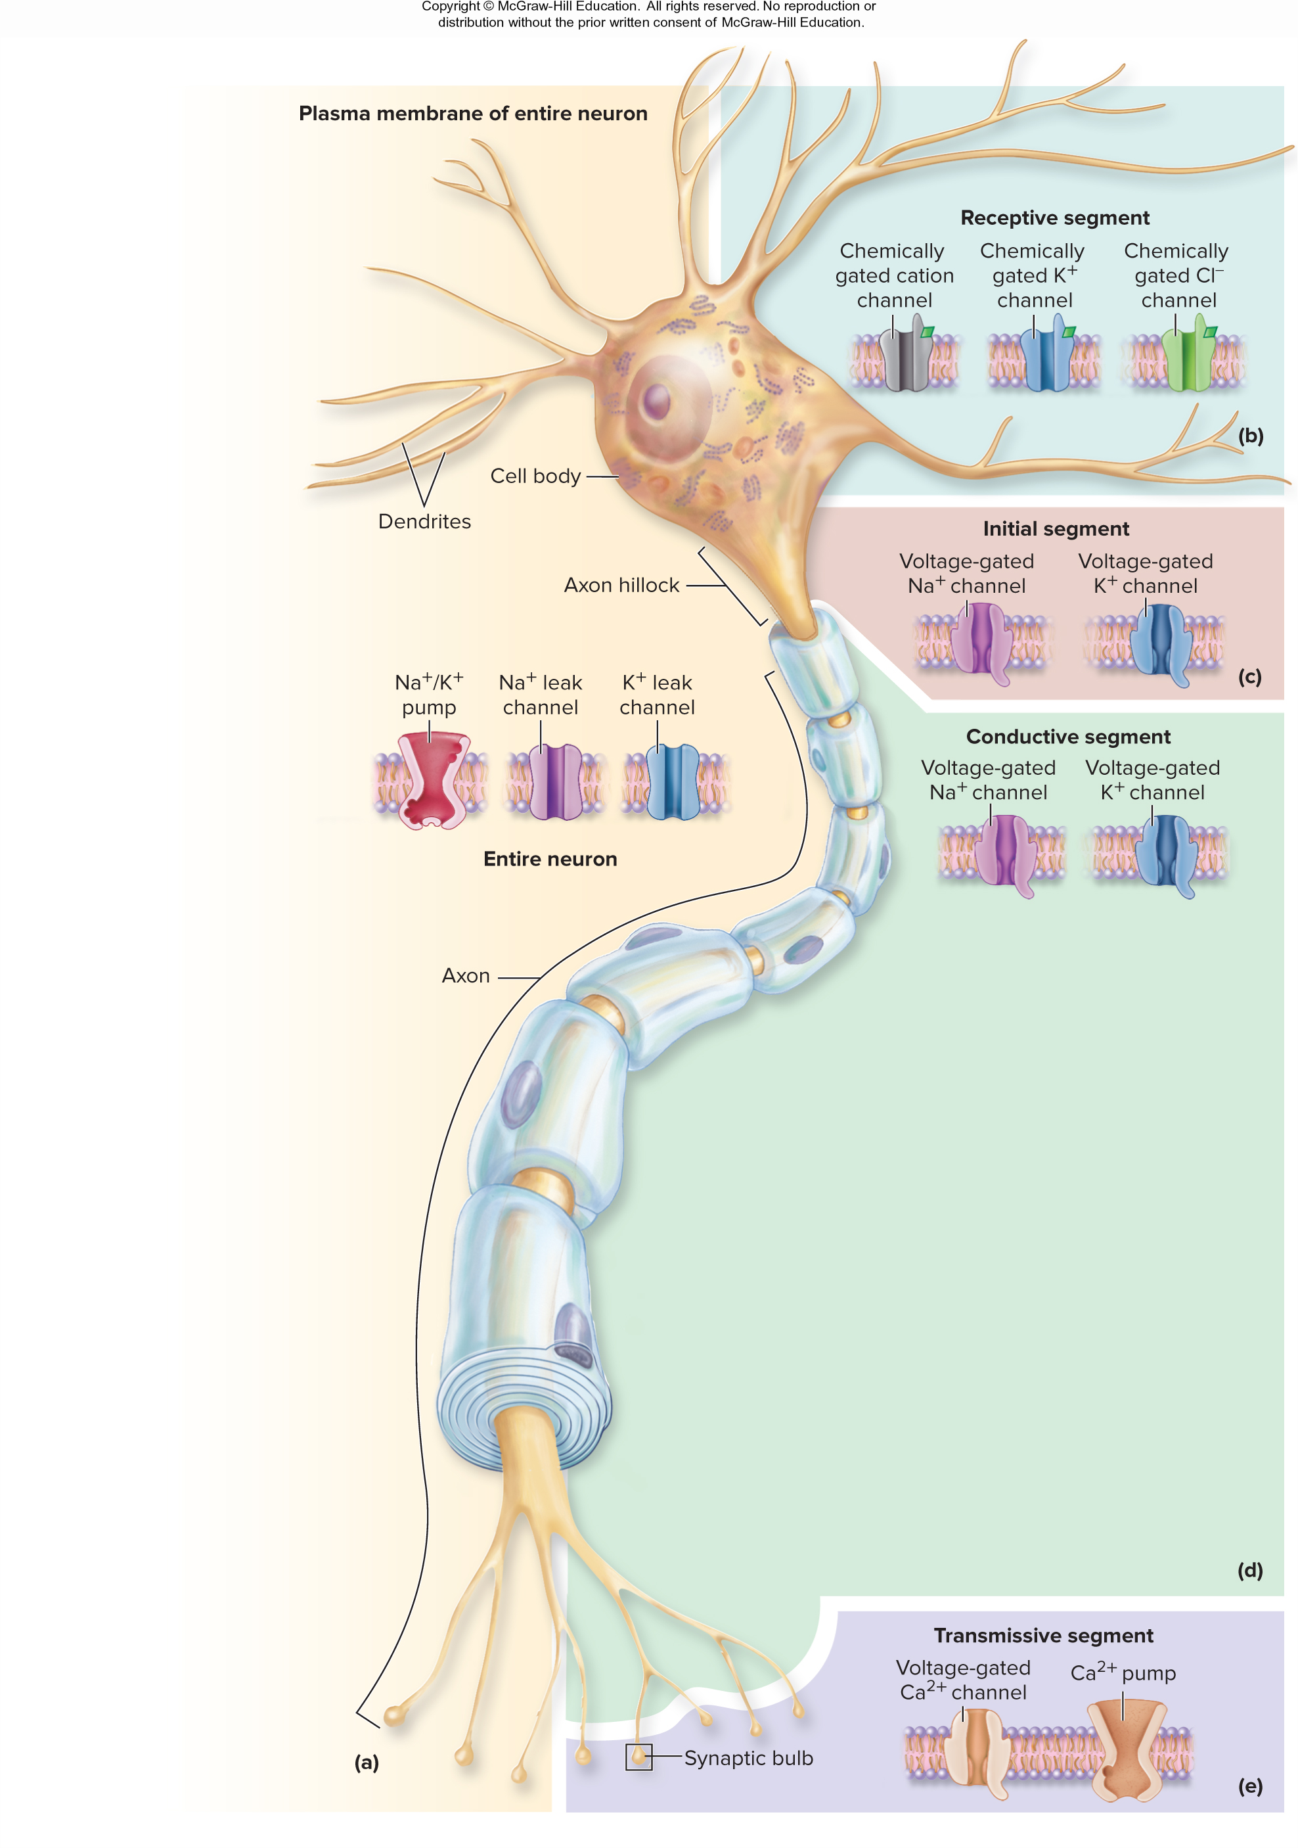
Distribution of Pumps and Channels in the Plasma Membrane of a Neuron 1
Figure 12.12(top)

Slide 19
Distribution of Pumps and Channels in the Plasma Membrane of a Neuron 2
Figure 12.12(bottom)

Slide 20
Section 12.6 What did you learn?
Describe the three states of voltage-gated Na+ channels in neurons.
Which functional segment of a neuron contains chemically gated channels? Which functional segments contain voltage-gated channels?

Slide 21
12.7 Introduction to Neuron Physiology
Learning Objectives
Integrate the concepts of voltage, current, and resistance with neuron structure and function.
Describe the conditions of a neuron at rest.
Define resting membrane potential, and state its typical value for neurons.
Explain how the resting membrane potential is established and maintained in neurons.

Slide 22
12.7a Neurons and Ohm’s Law 1
Electrical energy = movement of charged particles
Neuron activity dependent upon electrical current
  Voltage (potential energy)
    Amount of difference in electrical charge between two places
    Measured in volts or millivolts
  Current
    Movement of charged particles across barrier separating them
    Can be harnessed to do work
  Resistance
    Opposition to movement of charged particles (i.e., the barrier)
    An increase in resistance lowers the current

Slide 23
12.7a Neurons and Ohm’s Law 2
Ohm’s law
  Current = voltage/resistance
  Current increases with larger voltage and smaller resistance
As applied to neurons
  Charged particles are ions, and current is generated when ions diffuse through channels
  Voltage exists across the membrane due to unequal distribution of ions
  The membrane offers resistance to ion flow, and this resistance changes due to the actions of gated channels
    Resistance decreases when channels open

Slide 24
12.7b Neurons at Rest 1
Characteristics of resting neurons
  Ions are unevenly distributed across the plasma membrane due to the actions of pumps
    Higher concentration of K⁺ in cytosol verses interstitial fluid (IF)
    Higher concentrations of Na⁺, Cl–, Ca²⁺ in IF than in cytosol
  Gated channels are closed in the functional segments of the cell
  There is an electrical charge difference across the membrane
    Cytosol is relatively negative compared to IF
    Resting membrane potential (RMP) is typically –70 mV
    This difference can be measured with microelectrodes (one inside cell; one outside) and a voltmeter

Slide 25
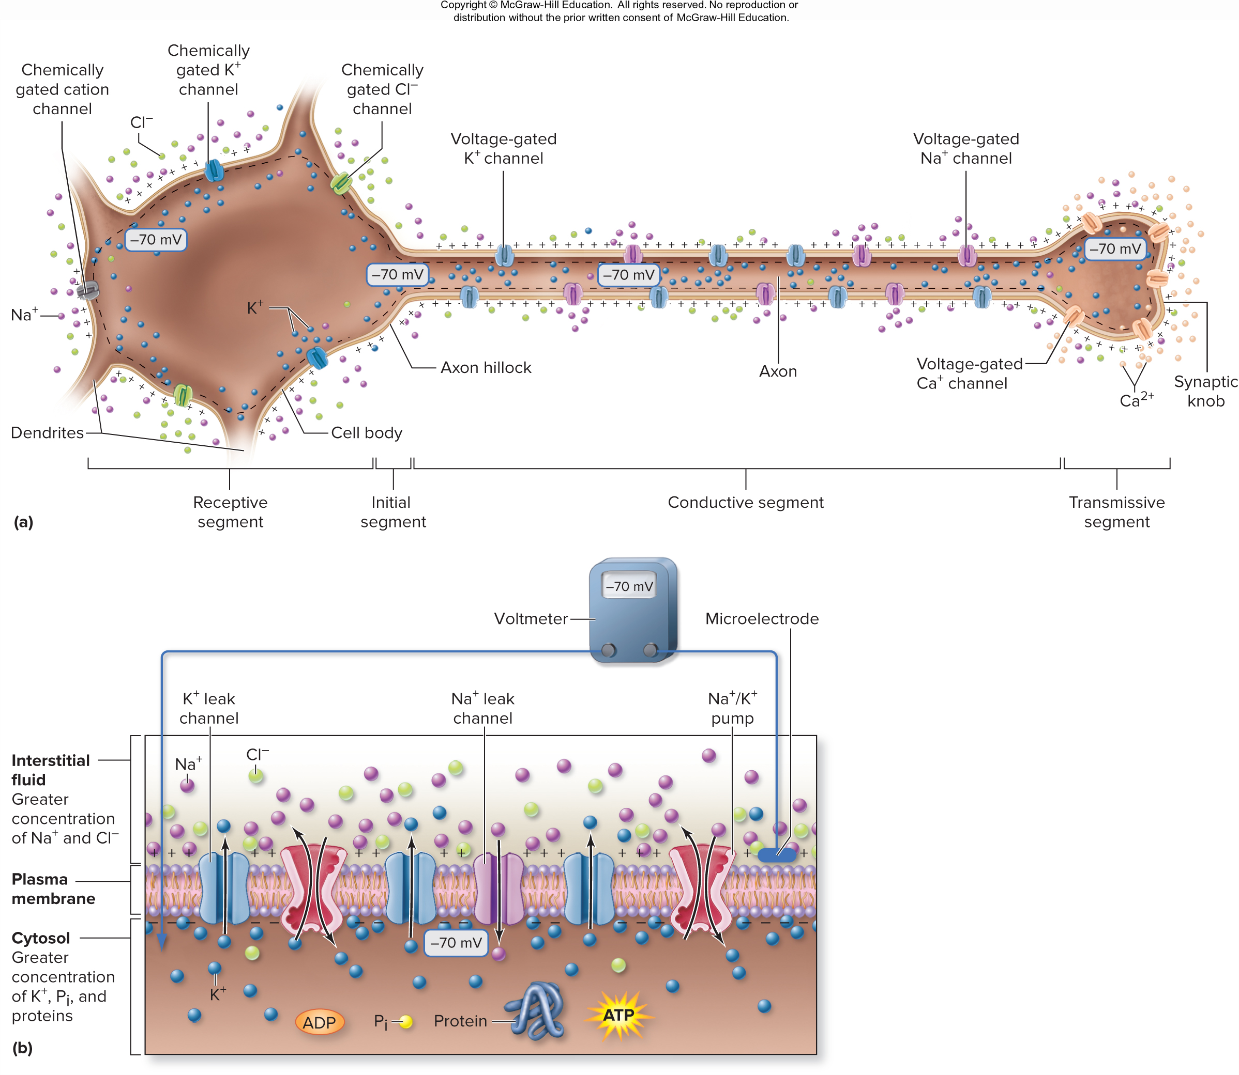
Neuron at Rest: Gated Channels and Ion Gradients
Figure 12.14a

Slide 26
12.7b Neurons at Rest 2
Resting membrane potential (RMP)
K⁺ diffusion is the most important factor in setting RMP
  K⁺ diffuses out of the cell due to its concentration gradient
  K⁺ diffusion out is limited by the electrical gradient (the pull of the negative RMP on the positive ion)
  If K⁺ were the only ion that leaked, RMP would be where the K⁺ concentration and electrical gradients are at equilibrium (–90 mV)
Since there are a few Na⁺ leak channels, Na⁺ also influences RMP
  Na⁺ diffuses in due to its concentration gradient and the electrical gradient
  This small Na⁺ leakage means RMP is less negative (–70 mV)

Slide 27
12.7b Neurons at Rest 3
Resting membrane potential (RMP) (continued )
The role of Na⁺/K⁺ pumps
  By pushing 3 positive charges out and pushing in only 2, the pump contributes about –3 mV (of the –70 mV total)
  More importantly, it maintains the concentration gradients for these ions

Slide 28
Neuron at Rest: Resting Membrane Potential
Figure 12.14b

Slide 29
Section 12.7 What did you learn?
What is the role of ions, the phospholipid bilayer, and plasma membrane channels in neurons relative to the concepts of current, voltage, and resistance?
Describe the conditions of a neuron at rest in terms of the RMP; concentration gradients for Na+, K+, Cl– along the entire neuron and Ca2+ at the synaptic knob; and the state of the gated channels.
Explain how an RMP is established and maintained in neurons.

